Slide 1
EBGN645: Day 4
Fun with GAMS

Slide 2
Notes
Repo updated
Events:
Career Fair next week
Gem show this week
Office hours still on for this week
Next week will be changing schedule a little bit
Need to leave at noon (preferably ~2 minutes prior)

Slide 3
Agenda
Practice Payne presentation (~12 minutes)
Practicing GAMS/GitHub
(Very) Simple examples
Common errors
Introducing time
(slightly) less simple example, introduction of conditionals
Last 15 minutes – helping figure out computer issues
Tools to introduce:
Conditionals via dollar signs
Restarts/saves
gdxmerge
gdxdiff
globals
Note: all AI images are intentionally hacky

Slide 4
Ripley’s restaurant – A very simple model
Ripley works 40 hours per week making hamburgers, hot dogs, and french fries. The net revenue and time to make for each of the items is in the table below.
What is Ripley’s profit-maximizing production choice?
Item | Revenue | Cost | Hours
Hamburger | 1.5 | 0.75 | 0.5
Hot dog | 0.75 | 0.1 | 0.2
French fries | 0.25 | 0.05 | 0.1

Slide 5
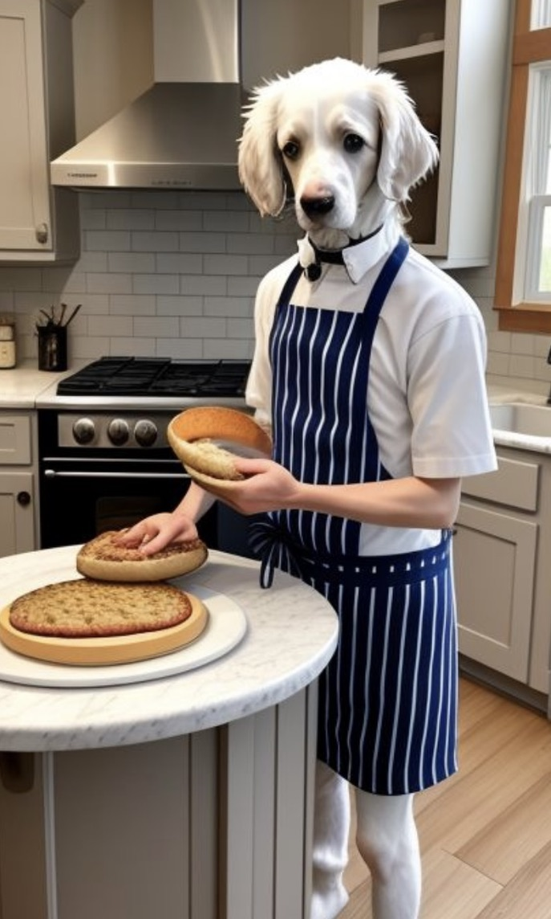
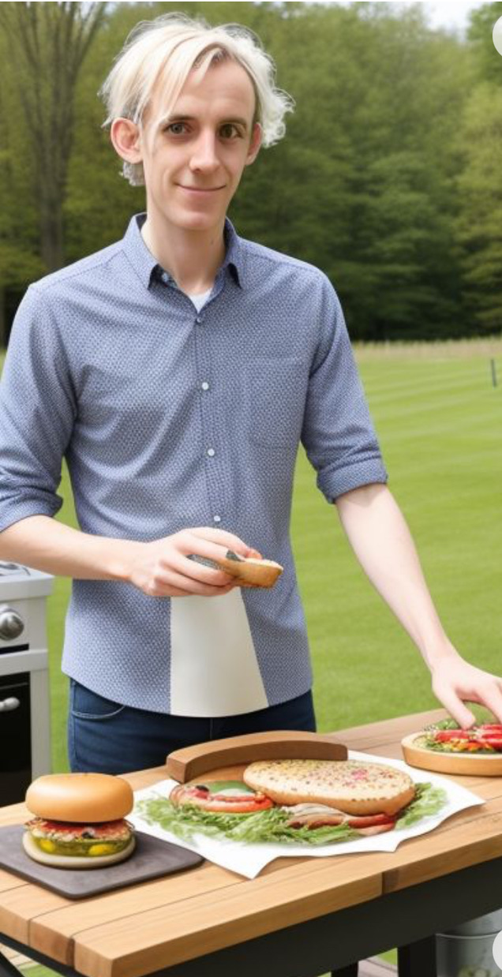
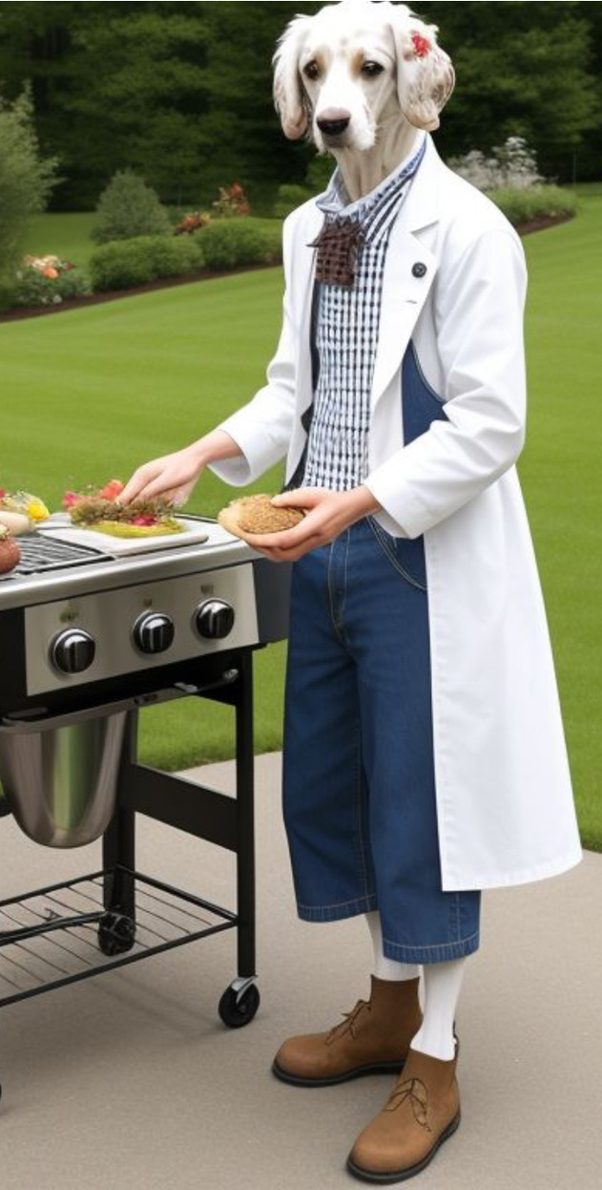
Ripley’s restaurant – visualized by (janky) AI

Slide 6
Writing a model
Always go in this order:
Sets/indices
Parameters
Variables
Objective function (when appropriate)
Constraints
See explanation/examples in INFORMS (Grievel et al.) or CCS papers
This is a requirement of any model for this course – homework/projects

Slide 7
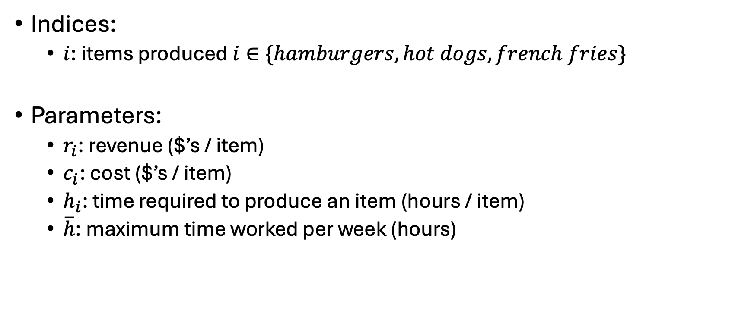
Ripley’s restaurant
Indices:
$i$: items produced $i∈\{hamburgers, hot dogs, french fries\}$
Parameters:
$r_{i}$: revenue ($’s / item)
$c_{i}$: cost ($’s / item)
$h_{i}$: time required to produce an item (hours / item)
$\overline{h}$: maximum time worked per week (hours)
Item | Revenue | Cost | Hours
Hamburger | 1.5 | 0.75 | 0.5
Hot dog | 0.75 | 0.1 | 0.2
French fries | 0.25 | 0.05 | 0.1

Slide 8
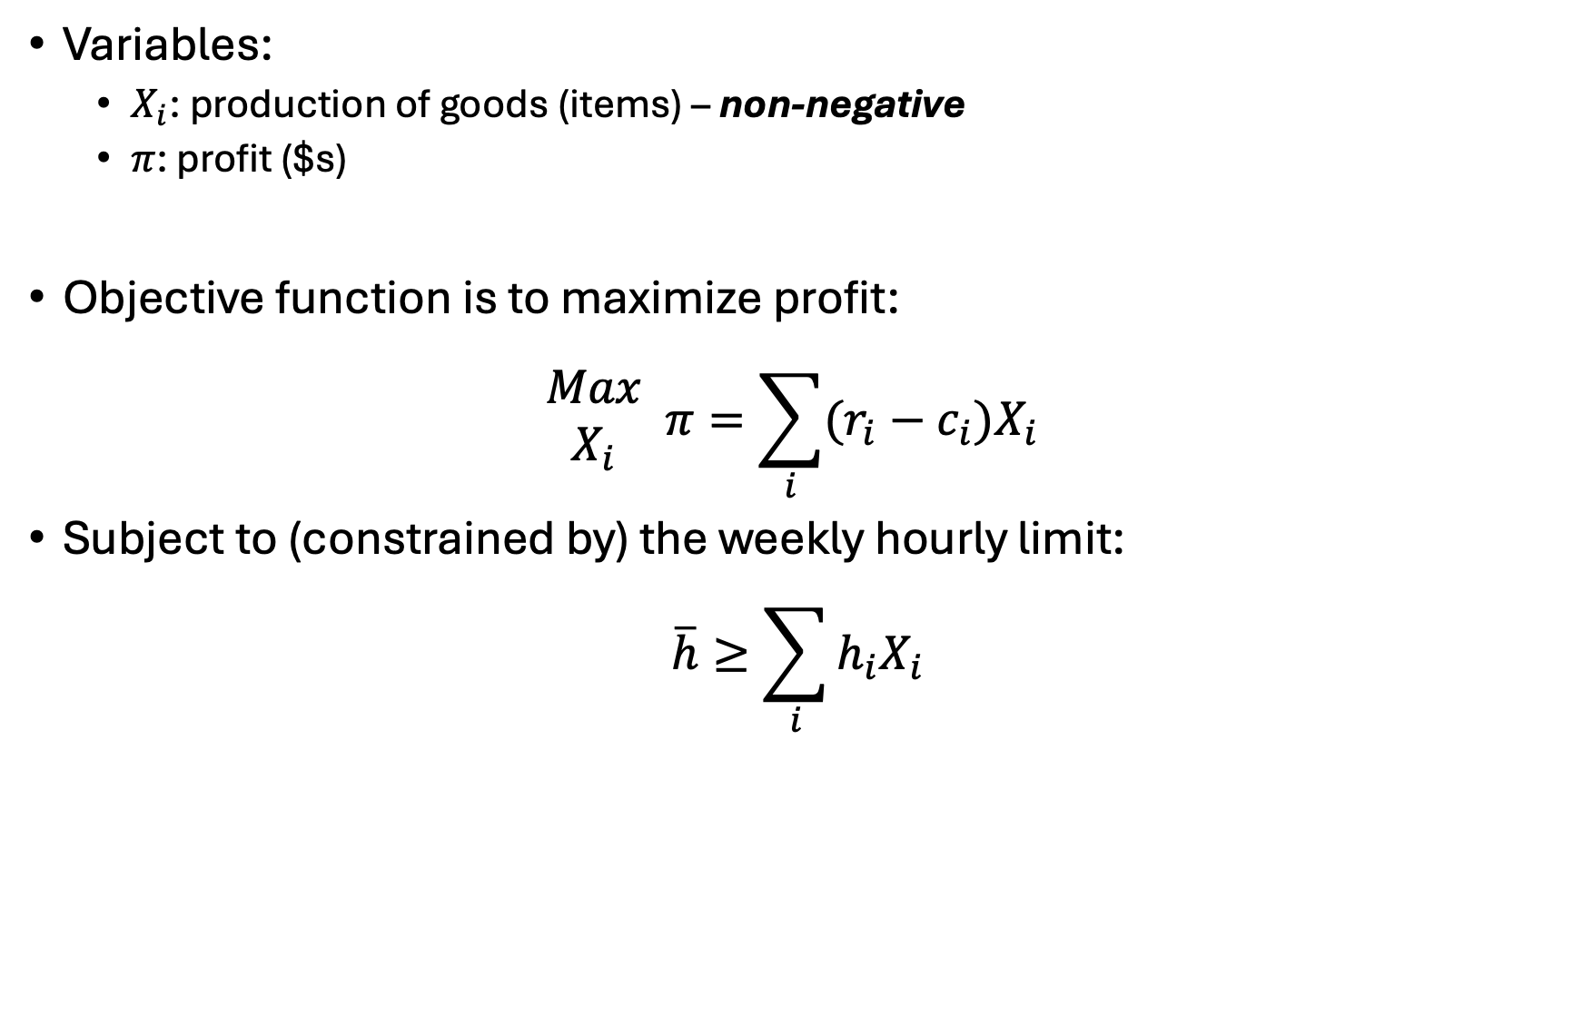
Ripley’s restaurant
Variables:
$X_{i}$: production of goods (items) – non-negative
$π$: profit ($s)
Objective function is to maximize profit:
$$\begin{matrix}Max \\ X_{i}\end{matrix} π=\sum_{i}{(r_{i}−c_{i})X_{i}}$$
Subject to (constrained by) the weekly hourly limit:
$$\overline{h}≥\sum_{i}{h_{i}X_{i}}$$

Slide 9
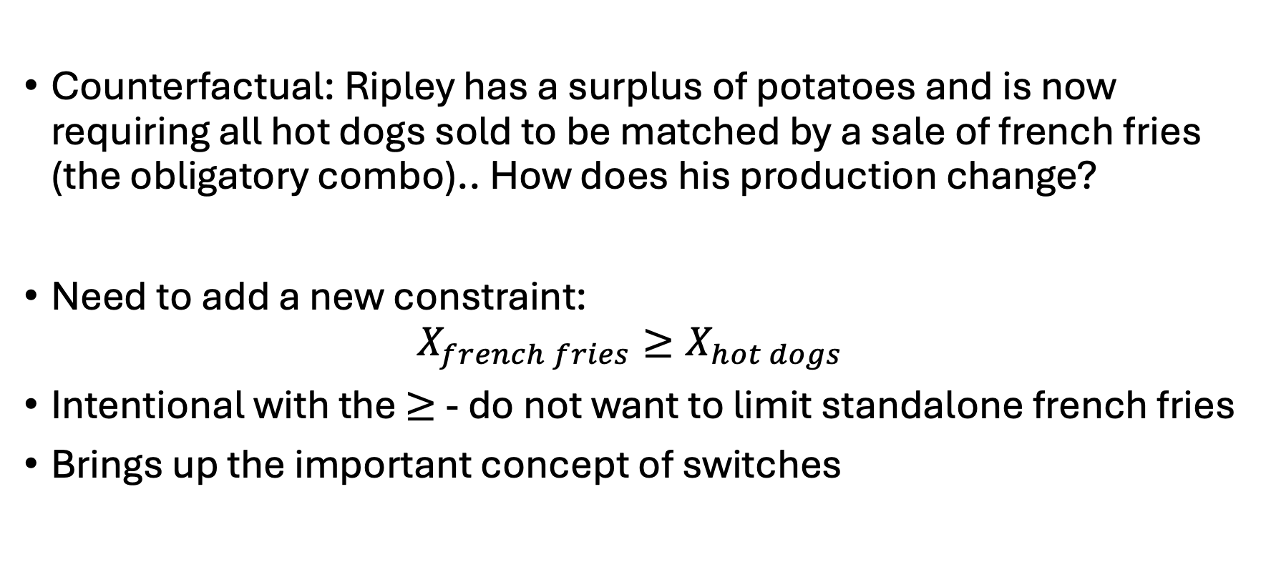
Ripley’s restaurant
Counterfactual: Ripley has a surplus of potatoes and is now requiring all hot dogs sold to be matched by a sale of french fries (the obligatory combo).. How does his production change?
Need to add a new constraint:
$$X_{french fries}≥X_{hot dogs}$$
Intentional with the $≥$ - do not want to limit standalone french fries
Brings up the important concept of switches

Slide 10
Globals (‘global arguments’)
Basically: passing information in from the terminal
Why? Don’t want to manually run, change things, run again, …
Prone to human error
Automation saves your sanity
Scripting helps for reproduction (of results)
Best for threading/queueing
Here – going to run this example twice:
Once with the switch enabled
.. then again without the switch enabled
Both times passing the argument from the command prompt

Slide 11
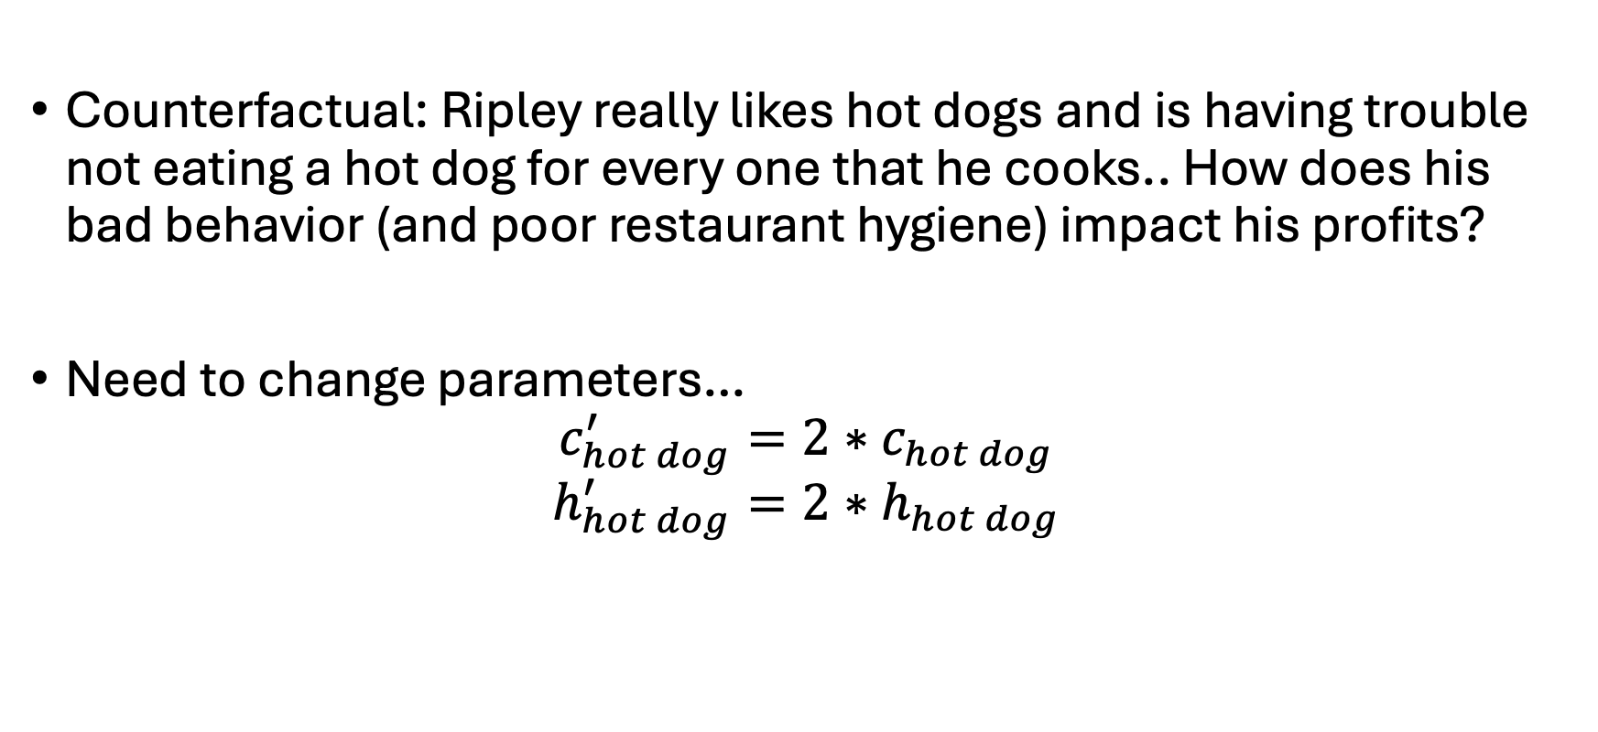
Ripley’s restaurant
Counterfactual: Ripley really likes hot dogs and is having trouble not eating a hot dog for every one that he cooks.. How does his bad behavior (and poor restaurant hygiene) impact his profits?
Need to change parameters…
$$c_{hot dog}^{′}=2∗c_{hot dog}$$
$$h_{hot dog}^{′}=2∗h_{hot dog}$$

Slide 12
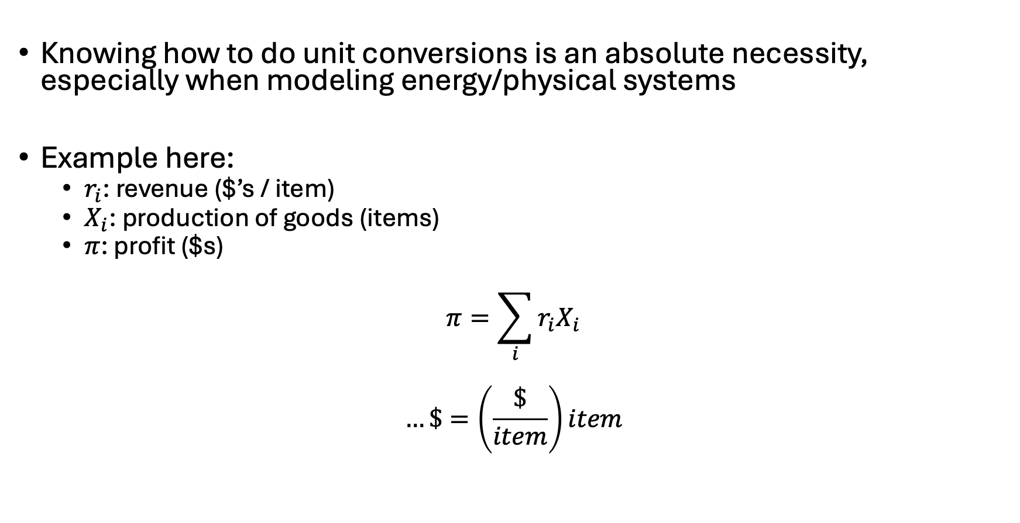
Notes on unit conversions
Knowing how to do unit conversions is an absolute necessity, especially when modeling energy/physical systems
Example here:
$r_{i}$: revenue ($’s / item)
$X_{i}$: production of goods (items)
$π$: profit ($s)
$$π=\sum_{i}{{r_{i}X}_{i}}$$
$$…\$=\left(\frac{\$}{item}\right)item$$

Slide 13
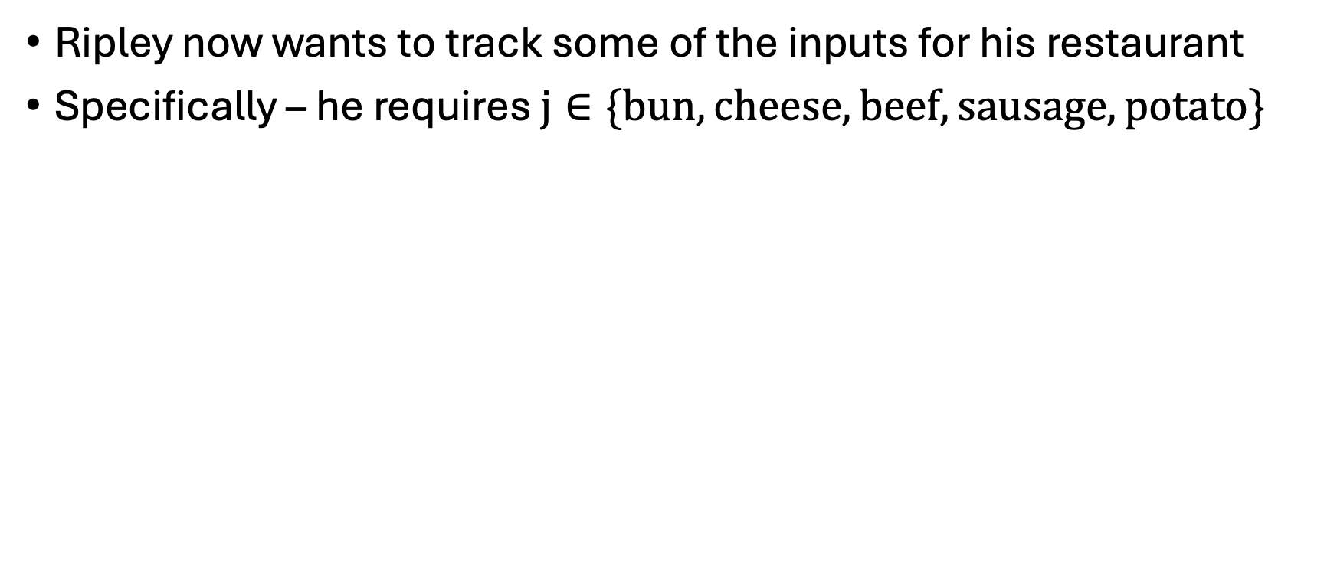
Ripley’s equipment requirements
Ripley now wants to track some of the inputs for his restaurant
Specifically – he requires $j∈\{bun,cheese,beef,sausage,potato\}$
Input | Hot Dog | Hamburger | French Fries
Bun | 1 | 1
Cheese |  | 1
Beef |  | 1
Sausage | 1
Potato |  |  | 2

Slide 14
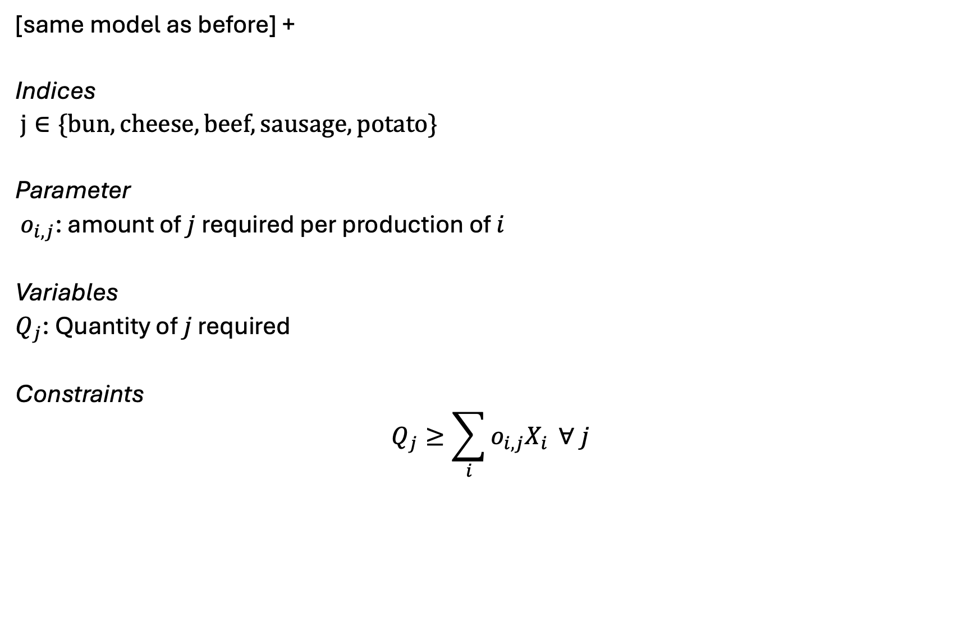
Extension to Ripley’s restaurant
[same model as before] +
Indices
$j∈\{bun,cheese,beef,sausage,potato\}$
Parameter
$o_{i,j}$: amount of $j$ required per production of $i$
Variables
$Q_{j}$: Quantity of $j$ required
Constraints
$$Q_{j}≥\sum_{i}{o_{i,j}X_{i}} ∀ j$$

Slide 15
Sparse matrix construction [I]
Solvers (CPLEX/Gurobi) are pretty good at eliminating irrelevant combinations of indices – e.g. Ripley doesn’t need to use a potato for his hot dog
-but- this only goes so far and, when you get to big models, the pre-solve step is unreliable

Slide 16
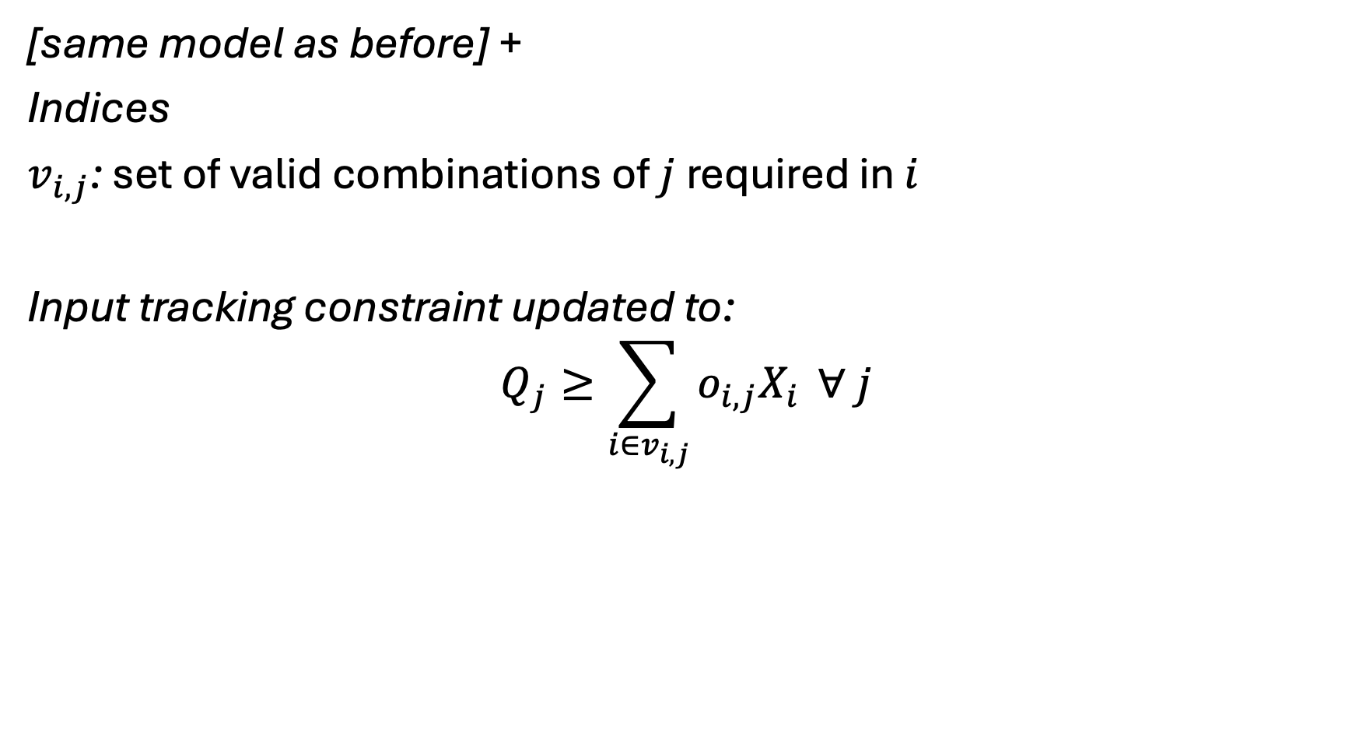
Sparse matrix construction [II]
[same model as before] +
Indices
$v_{i,j}$: set of valid combinations of $j$ required in $i$
Input tracking constraint updated to:
$$Q_{j}≥\sum_{i∈v_{i,j}}{o_{i,j}X_{i}} ∀ j$$

Slide 17
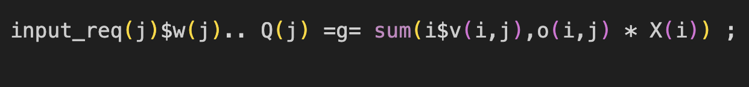
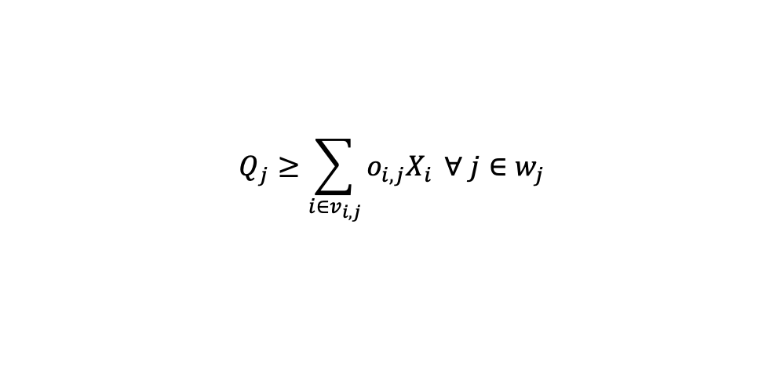
Translating math to GAMS
$$Q_{j}≥\sum_{i∈v_{i,j}}{o_{i,j}X_{i}} ∀ j∈w_{j}$$

Slide 18

Common errors in GAMS

Slide 19

Example 2: Ursula’s Utility
Ursula love’s eating pizza and beer. She is at Woody’s and is trying to decide what combination would maximize her utility/happiness. She has $20 in her pocket and forgot her wallet (luckily she’s a regular and they don’t ID her). Each piece of pizza costs $2 and gives her 2 utils of satisfaction while each beer costs $4 and gives her 5 utils of satisfaction. What is Ursula’s utility-maximizing set of consumption choices?
Also – what major utility assumption are we violating?

Slide 20
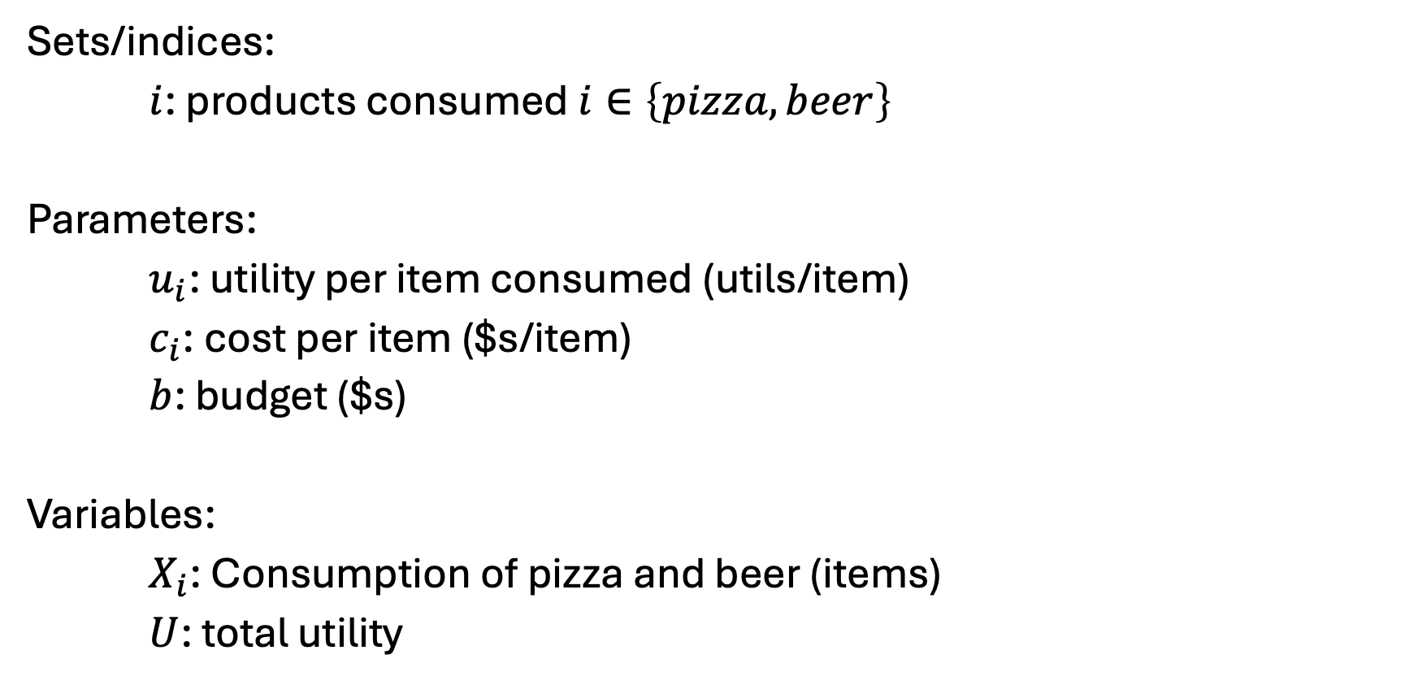
Ursula’s Utility [I] – Sets, parameters, variables
Sets/indices:
$i$: products consumed $i∈\left\{pizza, beer\right\}$
Parameters:
$u_{i}$: utility per item consumed (utils/item)
$c_{i}$: cost per item ($s/item)
$b$: budget ($s)
Variables:
$X_{i}$: Consumption of pizza and beer (items)
$U$: total utility

Slide 21
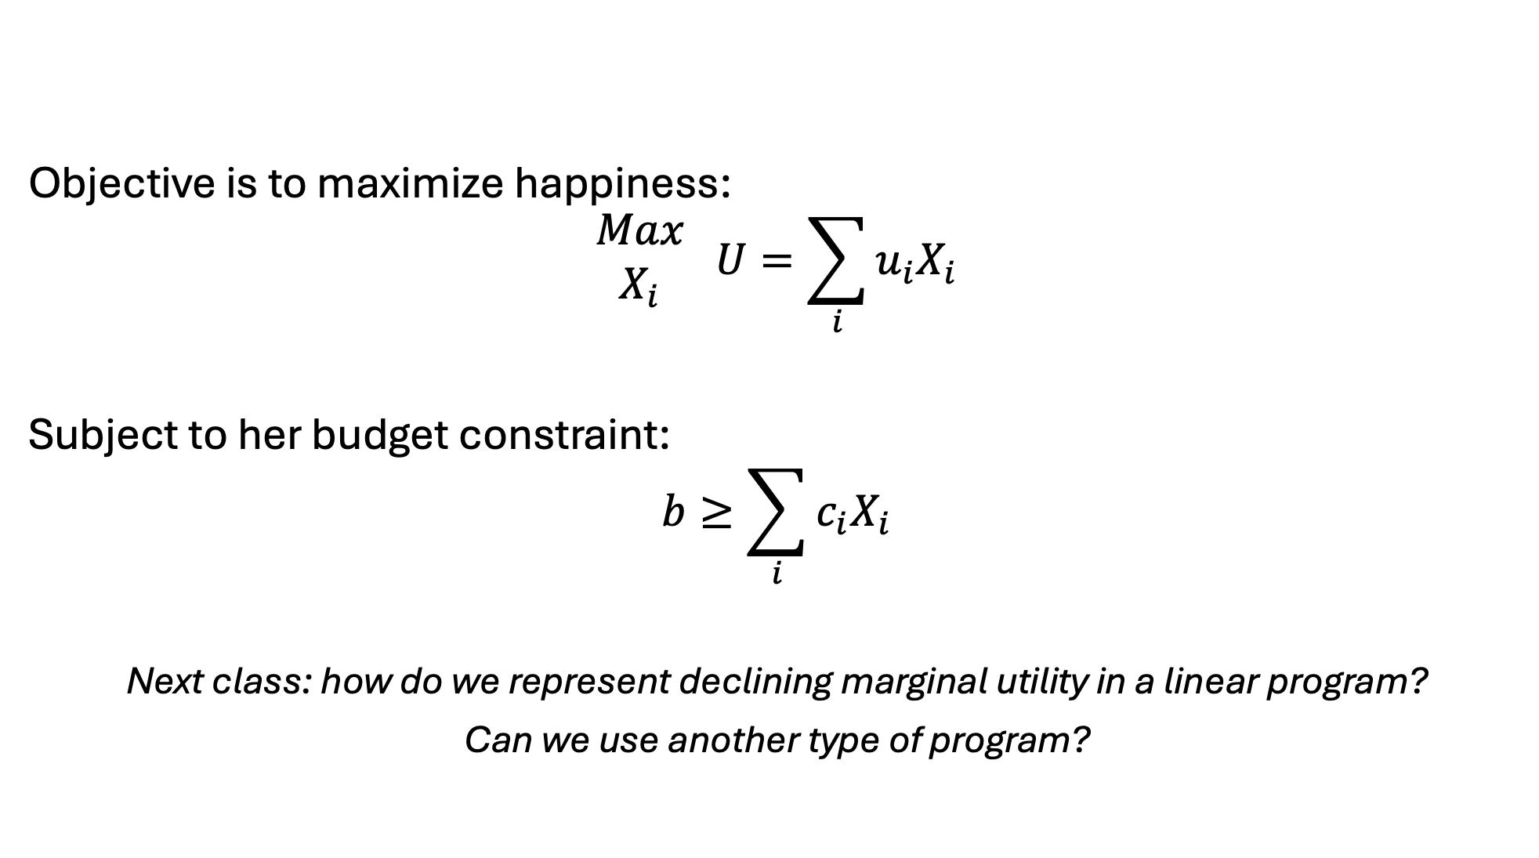
Ursula’s Utility [II] – Objective and constraints
Objective is to maximize happiness:
$$\begin{matrix}Max \\ X_{i}\end{matrix} U=\sum_{i}{u_{i}X_{i}}$$
Subject to her budget constraint:
$$b≥\sum_{i}{c_{i}X_{i}}$$
Next class: how do we represent declining marginal utility in a linear program?
Can we use another type of program?

Slide 22

Example 3: Franz Forestry
Franz owns land that produces lumber. Franz makes $100 net profit for every tree cut down. There is an initial stand of 100 trees and the trees grow at 1%* per year. Franz has a discount rate of 2%*. What is Franz profit-maximizing harvesting behavior?
*: Varied in counterfactuals

Slide 23
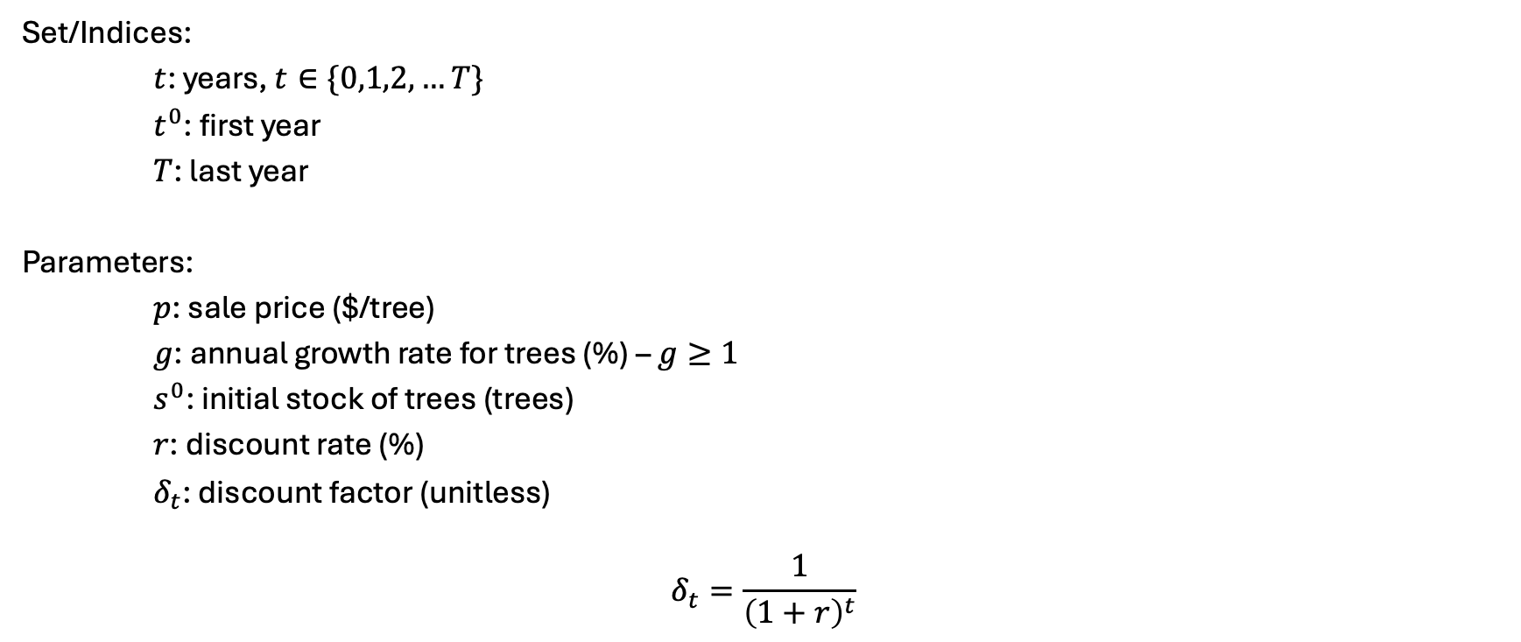
Franz Forestry [I] – sets and parameters
Set/Indices:
$t$: years, $t∈\{0,1,2,…T\}$
$t^{0}$: first year
$T$: last year
Parameters:
$p$: sale price ($/tree)
$g$: annual growth rate for trees (%) – $g≥1$
$s^{0}$: initial stock of trees (trees)
$r$: discount rate (%)
$δ_{t}$: discount factor (unitless)
$$δ_{t}=\frac{1}{{\left(1+r\right)}^{t}}$$

Slide 24
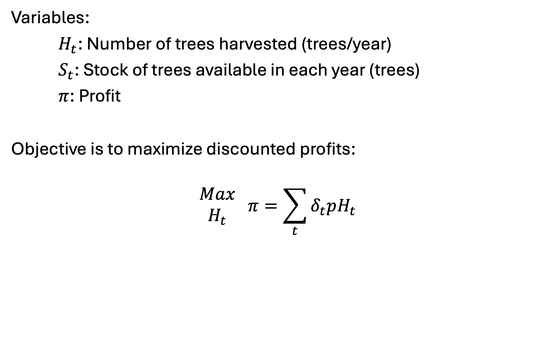
Franz Forestry [II] – variables and objective
Variables:
$H_{t}$: Number of trees harvested (trees/year)
$S_{t}$: Stock of trees available in each year (trees)
$π$: Profit
Objective is to maximize discounted profits:
$$\begin{matrix}Max \\ H_{t}\end{matrix} π=\sum_{t}{δ_{t}pH_{t}}$$

Slide 25
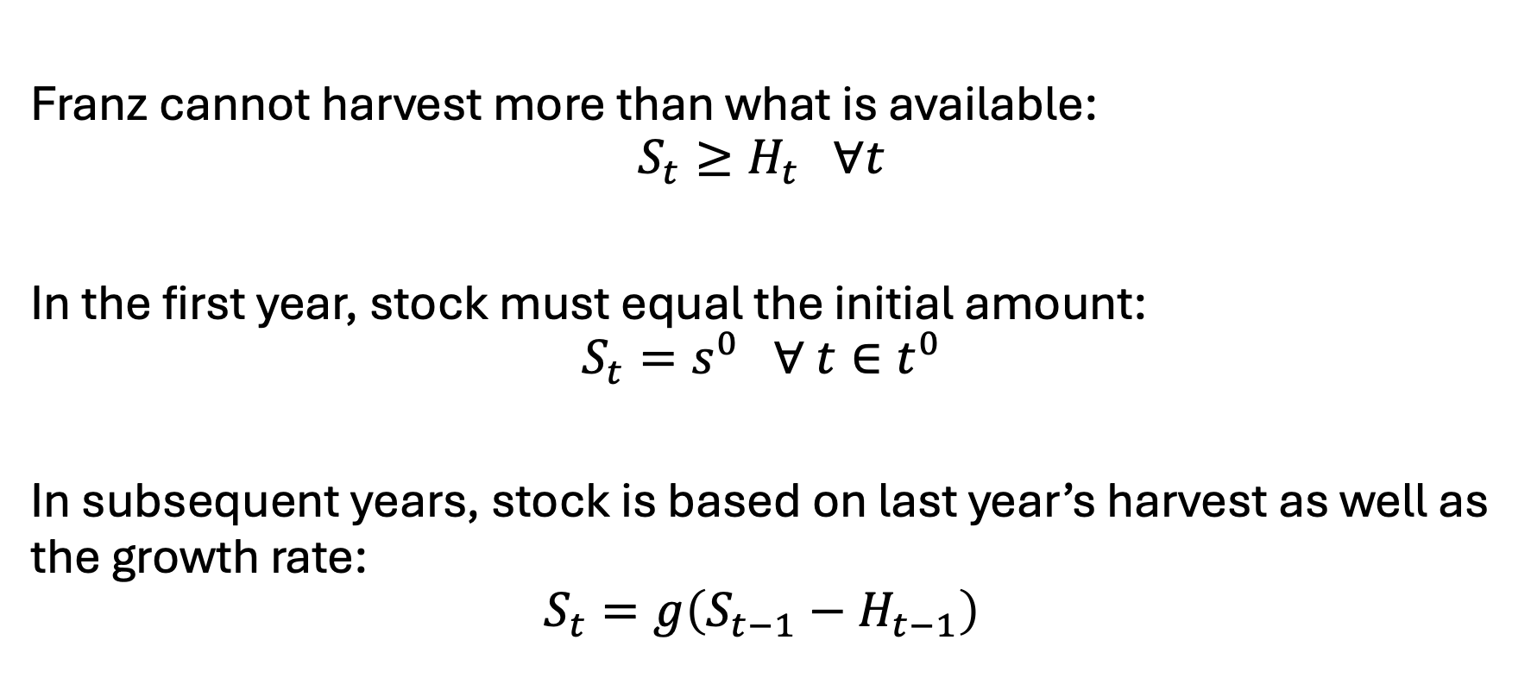
Franz Forestry [III] - constraints
Franz cannot harvest more than what is available:
$$S_{t}≥H_{t} ∀t$$
In the first year, stock must equal the initial amount:
$$S_{t}=s^{0} ∀ t∈t^{0}$$
In subsequent years, stock is based on last year’s harvest as well as the growth rate:
$$S_{t}=g\left(S_{t−1}−H_{t−1}\right)$$

Slide 26
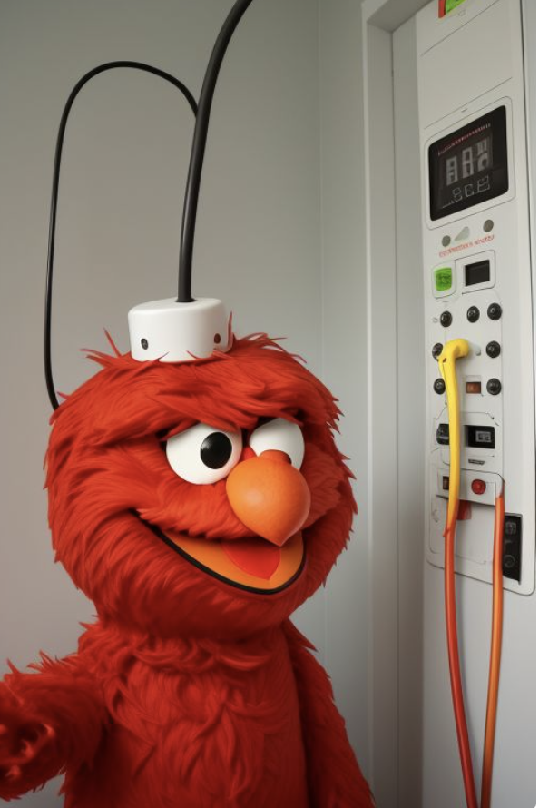
Example 4: Elmo’s Electricity
Elmo runs a small electricity utility. He has three electricity facilities: coal, gas, and wind. Each technology has its own cost and capacity. He must meet the hourly demand of his small town. What is Elmo’s cost-minimizing set of operational decisions?

Slide 27
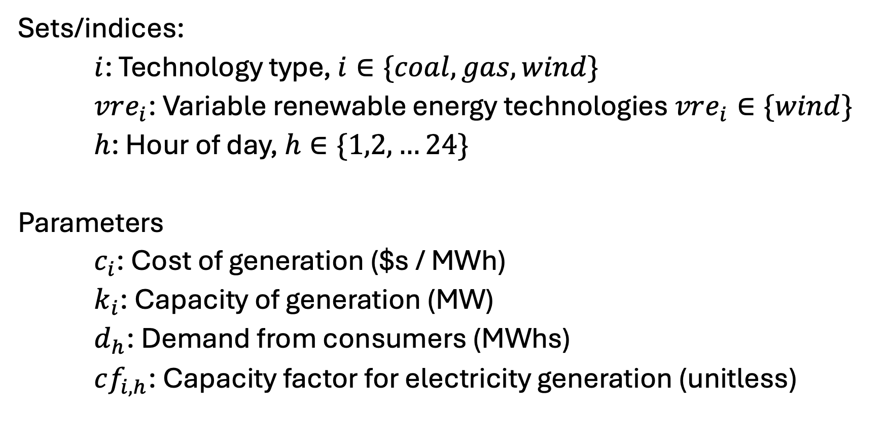
Elmo’s Electricity [I] – Sets and parameters
Sets/indices:
$i$: Technology type, $i∈\{coal, gas, wind\}$
$vre_{i}$: Variable renewable energy technologies $vre_{i}∈\{wind\}$
$h$: Hour of day, $h∈\{1,2,…24\}$
Parameters
$c_{i}$: Cost of generation ($s / MWh)
$k_{i}$: Capacity of generation (MW)
$d_{h}$: Demand from consumers (MWhs)
$cf_{i,h}$: Capacity factor for electricity generation (unitless)

Slide 28
Elmo’s electricity [II] - data
See spreadsheet - EBGN645_Data_Day3.xlsx

Slide 29
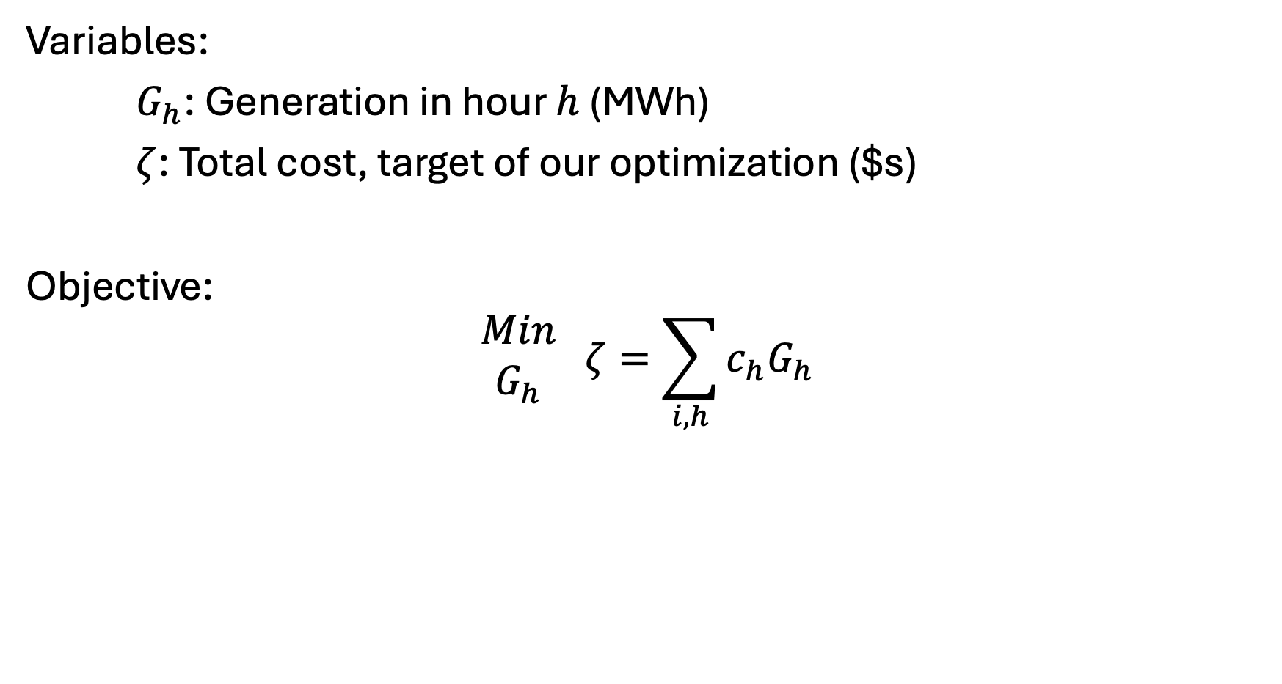
Elmo’s Electricity [III] – Variables and objective
Variables:
$G_{h}$: Generation in hour $h$ (MWh)
$ζ$: Total cost, target of our optimization ($s)
Objective:
$$\begin{matrix}Min \\ G_{h}\end{matrix} ζ=\sum_{i,h}{c_{h}G_{h}}$$

Slide 30
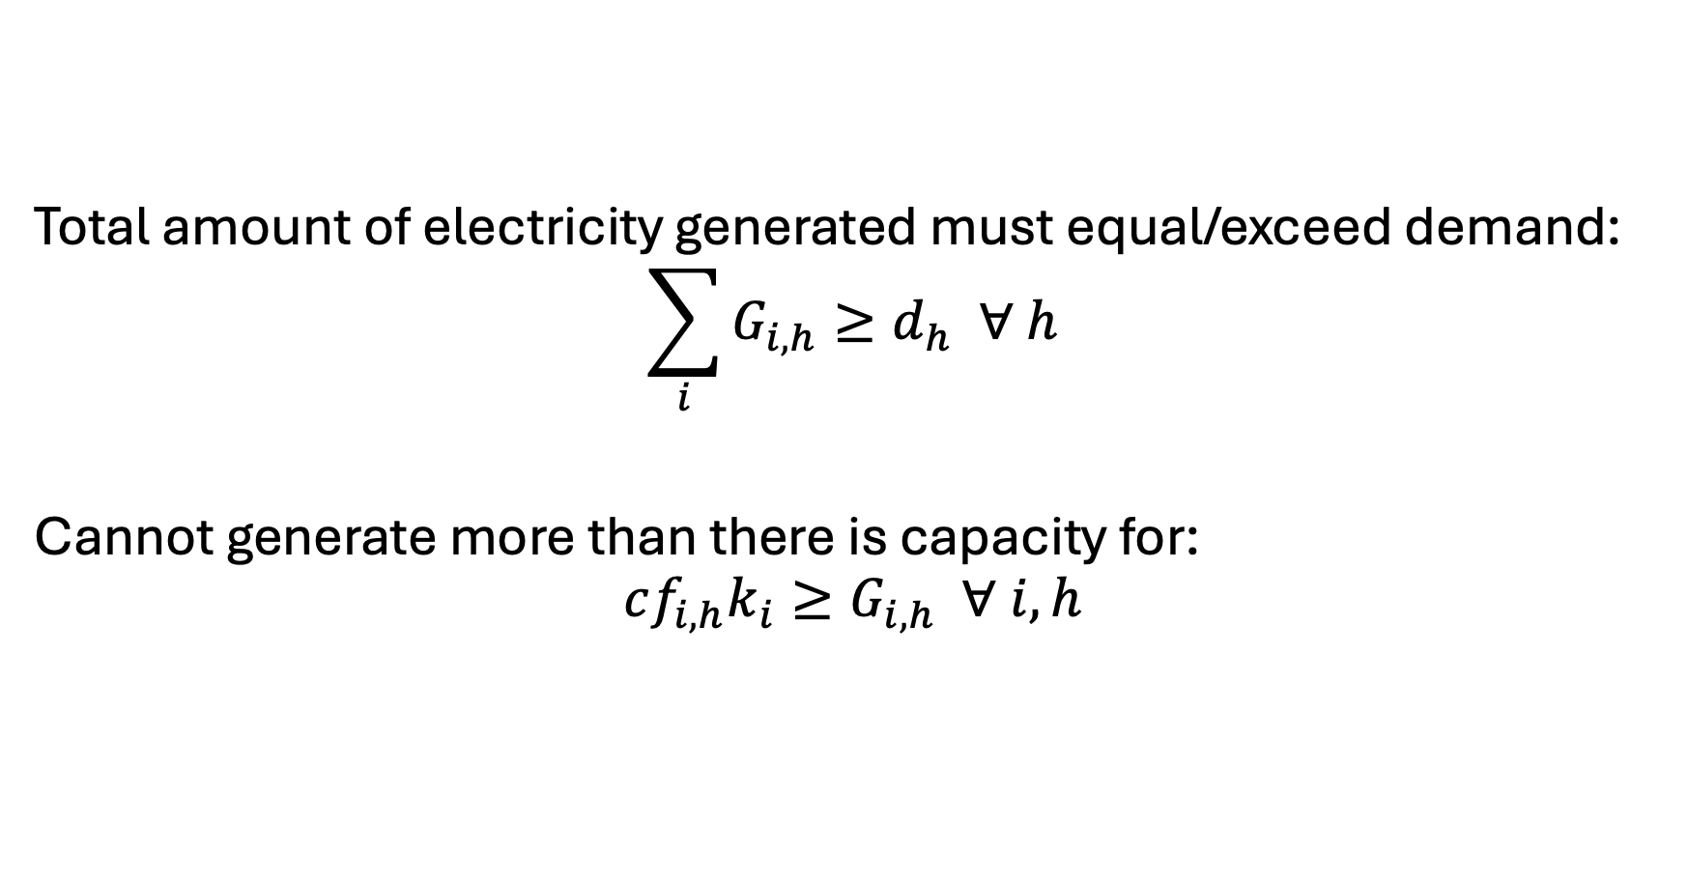
Elmo’s Electricity [IV] - Constraints
Total amount of electricity generated must equal/exceed demand:
$$\sum_{i}{G_{i,h}}≥d_{h} ∀ h$$
Cannot generate more than there is capacity for:
$$cf_{i,h}k_{i}≥G_{i,h} ∀ i,h$$

